Slide 1
PFunc: Modern Task Parallelism For Modern High Performance Computing
Prabhanjan Kambadur,
Open Systems Lab, Indiana University

Slide 2
Overview
Motivate the problem
Need for another task parallel solution
PFunc, a library-based solution for task parallelism
Introduce the Cilk model
Discuss PFunc’s features using fibonacci
Case studies
Demand-driven DAG execution
Frequent pattern mining
Sparse CG
Conclusion and future work

Slide 3
Motivation
Parallelize a wide-variety of applications
Traditional HPC, Informatics, mainstream
Parallelize for modern architectures
Multi-core, many-core and GPGPUs
Enable user-driven optimizations
Fine tune application performance
No runtime penalties
Mix SPMD-style programming with tasks

Slide 4
Task parallelism and Cilk
Program broken down into smaller tasks
Independent tasks are executed in parallel
Generic model of parallelism
Subsumes data parallelism and SPMD parallelism
Cilk is the most successful implementation
Leiserson et al
Base language C and C++
Work-stealing scheduler
Guaranteed bounds and space and time

Slide 5
Cilk-style parallelization
Order of completion
1 Thread
Order of discovery
11
n
1
5
n-1
n-2
2
10
7
3
n-2
n-3
n-3
n-4
3
4
6
6
8
9
9
1
n-3
n-4
n-5
n-6
11
4
5
10
8
2
7
Depth-first discovery, post-order finish
Notes:
In theory, the DFS execution is slightly altered because of the fact that all the children of a node are put on the queue and then other empty threads are given a chance to actually steal work from them. Note that this is not how its depicted here in this picture.

Slide 6
Cilk-style parallelization
Thread-local Deques
n
Thd 1 | Thd 2
n-5 | n-3
n-6 | n-4
n-4 | n-3
n-2 | n-2
n | n-1
Thd 1 | Thd 2
n-3 | n-4
n | n-2
 | n-1
Thd 1 | Thd 2
n | n-4
 | n-3
 | n-2
 | n-1
Thd 1 | Thd 2
n
Thd 1 | Thd 2
n-2 | n-1
n
Thd 1 | Thd 2
n-2
n-1
n
n-1
n-2
1. Breadth-first theft.
2. Steal one task at a time.
3. Stealing is expensive.
n-2
n-3
n-3
n-4
n-3
n-4
n-5
n-6
Steal (n-1)
Steal (n-3)
Notes:
What is labeled is the order of completion
The table shows the tasks in the queue. A will complete last, but is taken off the queue regardless.

Slide 7
Drawbacks of Cilk
Scheduling policy is hard-coded
Tasks cannot have priorities
Difficult to switch task scheduling policy
Divide and conquer is a must
Refactoring algorithms a must!
Otherwise data locality between tasks is not exploited
Fully-strict computation model
Task graph is always a tree-DAG
Cannot directly execute general DAG structures
Cannot mix SPMD and task parallelism

Slide 8
PFunc: An overview
Library-based solution for task parallelism
C/C++ APIs
Extends existing task parallel feature-set
Cilk, Threading Building Blocks (TBB), Fortran M, etc
Fully customizable
Generic and generative programming principles
No runtime penalty for customizations
Portable
Linux, OS X and AIX
Windows release soon!

Slide 9
PFunc: Feature set
Feature | Explanation
Scheduling Policy | Determines task scheduling (eg., cilkS)
Compare | Ordering function for the tasks (eg., std::less<int>)
Functor | Type of the function to be parallelized
struct fibonacci;
typedef pfunc::generator <cilkS, // Scheduling policy
pfunc::use_default, // Compare
fibonacci> // Functor
my_pfunc;

Slide 10
PFunc: Nested types
Type | Explanation
Attribute | Attached to each task. Used for affinity, priority, etc
Group | Attached to each task. Used for SPMD-style programming
Task | Handle to a spawned task. Used for status checks
Taskmgr | Represents PFunc’s runtime. Encapsulates threads and queues
typedef my_pfunc::attribute my_attr;
typedef my_pfunc::group my_group;
typedef my_pfunc::task my_task;
typedef my_pfunc::taskmgr my_taskmgr;

Slide 11
Fibonacci numbers
my_taskmgr gbl_taskmgr;
struct fibonacci {
fibonacci (const int& n) : n(n), fib_n(0) {}
int get_number () const { return fib_n; }
void operator () (void) {
if (0 == n || 1 == n) fib_n = n;
else {
task tsk;
fibonacci fib_n_1 (n−1), fib_n_2 (n−2);
pfunc::spawn (∗gbl_taskmgr, tsk, fib_n_1);
fib_n_2();
pfunc::wait (∗gbl_taskmgr, tsk);
fib_n = fib_n_1.get_number () + fib_n_2.get_number ();
}
}
private:
int fib_n;
const int n;
};

Slide 12
PFunc: Fibonacci performance
Threads | Cilk (secs) | PFunc/Cilk | PFunc/TBB
1 | 2.17 | 2.2178 | 0.5004
2 | 1.15 | 2.1135 | 0.5041
4 | 0.55 | 2.2131 | 0.5009
8 | 0.28 | 2.2114 | 0.4437
16 | 0.15 | 2.4944 | 0.4201
2x faster than TBB
2x slower than Cilk
Provides more flexibility than TBB or Cilk
* 4 socket quad-core AMD 8356 with Linux 2.6.24

Slide 14
New features in PFunc
Customizable task scheduling and task priorities
cilkS, prioS, fifoS and lifoS provided
Multiple task completion notifications on demand
Deviates from the strict computation model
Task groups
SPMD-style parallelization
Task affinities
Heterogeneous computers
Attach task to queues and queues to processor
Exception handling and profiling

Slide 15
Case Studies

Slide 16
Demand-driven DAG execution
Data-driven DAG execution has many shortcomings
Increased memory consumption in many applications
Over-parallelization (eg., Sparse Cholesky Factorization)
Strict computation model precludes
Demand-driven execution of general DAGs
Only supports execution of tree-DAGs
PFunc supports demand-driven DAG execution
Multiple task completion notifications
Task priorities to control execution

Slide 17
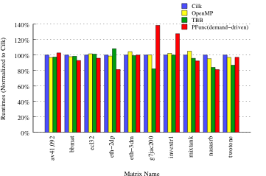
DAG execution: Runtime

Slide 18
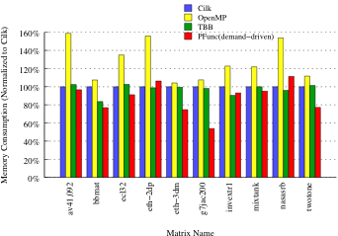
DAG execution: Peak memory usage

Slide 19
Frequent pattern mining (FPM)
FPM algorithms are not always recursive
The best known algorithm (Apriori) is breadth-first
Optimal execution depends on memory reuse b/w tasks
Current solutions do not support task affinities
Affinities exploited only in divide and conquer executions
Emphasis on recursive parallelism
PFunc allows custom scheduling and task priorities
Nearest neighbor scheduling algorithm
Hash-table based common prefix scheduling algorithm
Task priorities double as keys for tasks

Slide 20
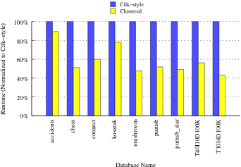
Frequent pattern mining

Slide 21
Iterative sparse solvers
Krylov-subspace methods such as CG, GMRES
Efficient parallelization requires
SPMD for unpreconditioned iterative sparse solvers
Task parallelism for preconditioners
Eg., incomplete factorization methods
Current solutions do not support SPMD model
PFunc supports SPMD through task groups
Barrier operation, group cancellation
Point-to-point operations coming soon!

Slide 22
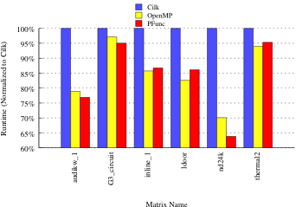
Conjugate gradient

Slide 23
Conclusions
PFunc increases tasking support for:
Modern HPC applications
DAG execution, frequent pattern mining, sparse CG
SPMD-style programming
Modern computer architectures
Future work
Parallelize more applications
Incorporate support for GPGPUs
https://projects.coin-or.org/PFunc

